Slide 1
WHAT IMPACTS SAFE INSTALLATION OF ESS
Lessons from the City University of New York’s Smart DG Hub
Daniella Leifer, Energy Storage Ombudsman, Sustainable CUNY Smart DG Hub
October 25, 2022

Slide 2
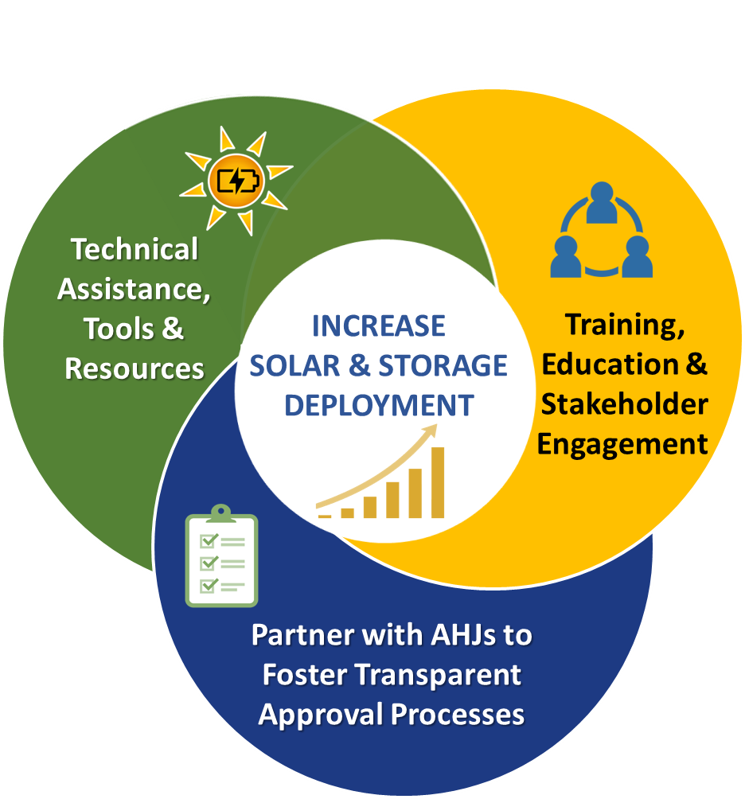
Sustainable CUNY – Smart DG (Distributed Generation) Hub
Partnership with NYC MOCEJ; funded by NYC & grants from state/federal/private to lead collaborative efforts with NYC AHJs
Houses NYC Solar & Storage Ombudsman Program - leading Stakeholder engagement to drive ESS market by identifying needs, barriers, & solutions
Develop Tools, Resources and provide Technical Assistance
www.smartdghub.com

Slide 3
Lessons Overview: What impacts the safe installation of ESS?
Webinar Key Topics:
What roles AHJs play in permitting and inspection
UL Standard 9540 and 9540A Test Method
Examples of adapting codes and standards for specific locations
ESS-readiness codes
Lessons from CUNY Smart DG Hub’s ESS-focused work:
Understanding Standards: what’s out there?
Standards Adaptation: does my jurisdiction need special amendments?
Installers/Developers: communication of requirements to “submit right the first time”

Slide 4
What Impacts the Safe Installation of ESS: Understanding recent evolutions of ESS standards
Understand standards – rapid evolution/development/improvement:
Original UPS/lead acid focus
NFPA 855; IFC 2021 – hot off the presses
UL 9540 & 9540A
Standards “universe” - expanded and specialized:
UL 9540 - system standard vs. component standards
UL 1973 – 2022 3rd ed.
EV batteries/ Micro-mobility batteries (e-bikes/scooters)

Slide 5
Timeline: ESS Permitting in NYC and National Standards
2017-2019
2020
2021
2022
National Standards
National Standards
National Standards
National Standards
2017 IFC 2018 published
2017 UL 9540A 1st edition
2018 UL 9540A 2nd edition
2018 UL 9540A 3rd edition
2019 NFPA 855 1st Ed.
2019 UL 9540A 4th Ed.
UL 9540 2nd Ed.
IFC 2021
NFPA 855 2nd Ed. draft released for public comment
UL 1973 3rd Ed.
NYC
NYC
NYC
2022 NYC Fire Code update
2022 NYC Building Code update
NYC Outdoor Permitting Guide 2nd Ed.
NYC UL 9540A Data Utilization Guide & Flow Charts
DOB NFPA 855 Working Group launch
FDNY Fire Code revision launch
DOB Bulletin 2020-023
NYC Zoning for Coastal Flood Resilience Amendment
FDNY Fire Code revision conclusion
NYC
2017 NYC Outdoor permitting initiative
2018 NYC outdoor permitting guide 1st Ed.
2018 Bulletin 2018-012
2019 Bulletin 2019-002
2019 Bulletin 2019-007
2019 3RCNY Rule 608-01 Outdoor ESS

Slide 6
What Impacts the Safe Installation of ESS: Adaptation of ESS standards to local needs
Current standards – prescriptive requirements cover most installations, BUT
May need some fine tuning via local amendments:
What are your jurisdiction’s unique needs/characteristics?
What are your jurisdiction’s ESS goals?
How codes/standards have been adapted in NYC:
Limited outdoor space
Tall buildings
Flood zone installations
The “Evergreen” principle

Slide 7
What Impacts the Safe Installation of ESS: Designers/developers/installers’ thorough understanding of AHJ requirements
Ensuring developers understand AHJ compliance reqs
AHJ involvement in communications is key
“Submit right the first time” – saves time & money for all
Outreach & education to communicate AHJs’ needs, processes – examples:
NYC/CUNY
NYS/NY-BEST
IREC

Slide 8
Thank you! Questions? Comments? Contact us at SmartDGhub@cuny.edu www.smartdghub.org

